Slide 1

UNIVERSITY INSTITUTE OF ENGINEERING
COMPUTER SCIENCE ENGINEERING
Bachelor of Engineering (Computer Science & Engineering)
Subject Name: Block chain Technology
Subject Code: 20_CST-412
Limitations of Block chain
Mapped with co2
Prepared By:
Er. Ankita Sharma
DISCOVER . LEARN . EMPOWER

Slide 2
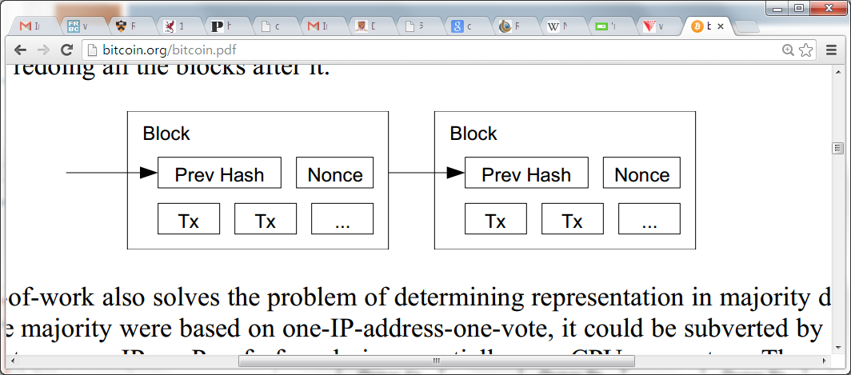
Reverting is Hard
Reverting gets exponentially hard as the chain grows.
2. Recompute nonce
3. Recompute the next nonce
1. Modify the transaction (revert or change the payer)

Slide 3
Practical Limitation
At least 10 mins to verify a transaction.
Agree to pay
Wait for one block (10 mins) for the transaction to go through.
But, for a large transaction ($$$) wait longer. Because if you wait longer it becomes more secure. For large $$$, you wait for six blocks (1 hour).

Slide 4
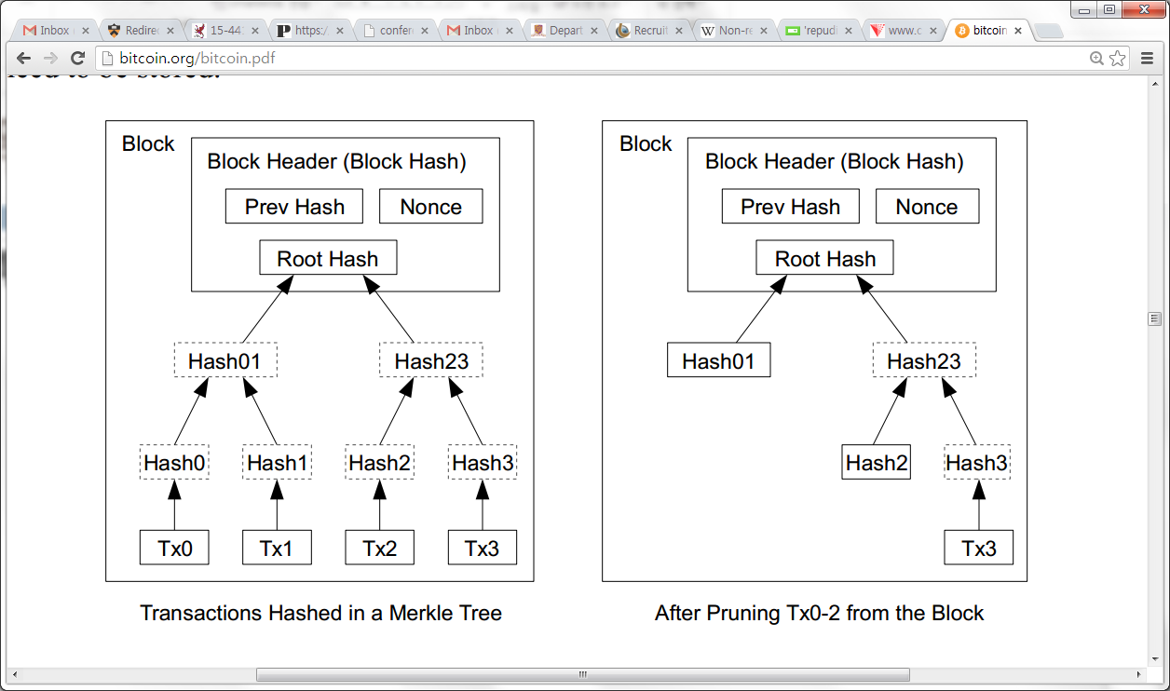
Optimizations
Merkle Tree
Only keep the root hash
Delete the interior hash values to save disk
Block header only contains the root hash
Block header is about 80 bytes
80 bytes * 6 per/hr * 24 hrs * 365 = 4.2 MB/year
Why keep use a Merkle tree?

Slide 5
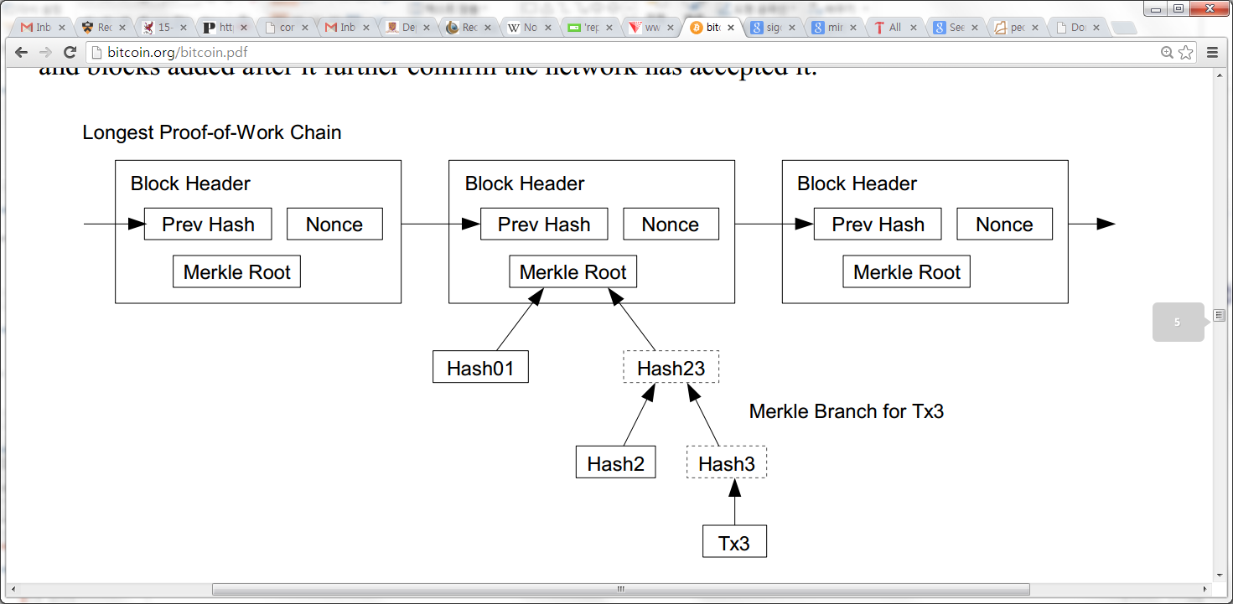
Simplified payment verification
Any user can verify a transaction easily by asking a node.
First, get the longest proof-of-work chain
Query the block that the transaction to be verified (tx3) is in.
Only need Hash01 and Hash2 to verify; not the entire Tx’s.

Slide 6
BitCoin Economics
Rate limiting on the creation of a new block
Adapt to the “network’s capacity”
A block created every 10 mins (six blocks every hour)
How? Difficulty is adjusted every two weeks to keep the rate fixed as capacity/computing power increases
N new Bitcoins per each new block: credited to the miner → incentives for miners
N was 50 initially. In 2013, N=25.
Halved every 210,000 blocks (every four years)
Thus, the total number of BitCoins will not exceed 21 million. (After this miner takes a fee)

Slide 7
Privacy Implications
No anonymity, only pseudonymity
All transactions remain on the block chain– indefinitely!
Retroactive data mining
Target used data mining on customer purchases to identify pregnant women and target ads at them (NYT 2012), ended up informing a woman’s father that his teenage daughter was pregnant
Imagine what credit card companies could do with the data

Slide 8
Zerocoin
A distributed approach to private electronic cash
Extends Bitcoin by adding an anonymous currency on top of it
Zerocoins are exchangeable for bitcoins

Slide 9

What is a zerocoin?
A zerocoin is:
Economically: a promissory note redeemable for a bitcoin
Cryptographically: an opaque envelope containing a serial number used to prevent double spending
823848273471012983

Slide 10

Commitments
812...
Allow you to commit to and later reveal a value
Binding: value cannot be tampered with
Blinding: value cannot be read until revealed
812..

Slide 11
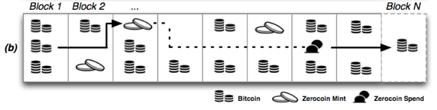
Zerocoins: where do they come from?
Anyone can make one
Choose a random serial number and commit to it
Mint a zerocoin by putting a mint transaction in the block chain which “spends” a bitcoin and includes the commitment
Spending a zerocoin gives the recipient a bitcoin

Slide 12
Zerocoins: ...and where do they go?
The “spent” bitcoins end up escrowed
To spend a zerocoin
You reveal the serial number
Prove it is from some zerocoin in the block chain
Put the spent serial number in the block chain

Slide 13
Zero-knowledge proofs
Zero-knowledge [Goldwasser, Micali 1980s, and beyond]
Prove knowledge of a witness satisfying a statement
Specific variant: non-interactive proof of knowledge
Here we prove we know:
The serial number of a zerocoin
That the coin is in the block chain

Slide 14

Zero-knowledge proof
Inefficient approach
Identify all valid zerocoins in the block chain (call them )
Prove that S is the serial number of a coin C and
This “OR” proof is O(N)
Zerocoin uses cryptographic accumulators
Sublinear

Slide 15



Zerocoin protocol
Generate a commitment to a random serial number S:
(Store serial number S and randomness r)
Accumulate all valid coins, compute witness wi
Reveal S and prove knowledge of witness to commitment accumulation and its randomness r
where is prime

Slide 16
Discussion
The future of Bitcoin?
Attacks on Zerocoin?
Should we tradeoff privacy for usability? Is privacy a main principle?

